Slide 1
Land Market & Purchasing Basics
Samantha Brooks & Wade McAlpine
Northwest Farm Credit Services

Slide 2
What goes into a land purchase?
#1 Rule = Communication
Listed on the market?
Realtor or no realtor?
Lawyer or no lawyer?
Accountant
Banker(s)
Insurance Agent (Liability/Irrigation Equipment/Etc.)

Slide 3
Land Purchase (continued)
Buy/Sell Agreement
  Does not have to be a novel
  Allow for ample time to close
  Major Items:
    Buyer and seller
    Legal Description
    Price (Earnest Money?)
    Title Contingency
    Financing Contingency
    Who handles closing?
    Who pays for what closing costs?
  Minor Items:
    Appraisal Contingency
    Allocation between land & buildings for Uncle Sam

Slide 4
Land Purchase (continued)
Title Company
  Earnest Money
  Title Insurance (VERY IMPORTANT!!)
    Access?
    Liens?
Stay in contact with your friendly banker(s)
  Projections/Balance Sheet
  Bank orders appraisal
    Risk Management

Slide 5
Land Purchase (continued)
Day of Closing
  Practice up on your autograph
  Title Company will take care of you
  Will not actually see the cash
    Besides Earnest Money & Closing Costs

Slide 6
Own vs. Lease
American Dream to “own” assets
  Does it make sense (at least at this point in time)?
Pros
  Pride of ownership
  Asset for the balance sheet
  Can “have/keep it in the family”
  Pass on to future generations
  Ability to make all the management decisions

Slide 7
Own vs. Lease (continued)
Cons
  Property Taxes
  Liability Insurance
  No fast exit (not always the case)
  Purchase payment versus lease payment
    Cannot deduct principal portion of payment
    Can deduct entire lease payment
Leasing = Easier to operate with limited capital
Cash is King!

Slide 8
Example: Lease or Buy? (100% financing)
160 acres of dry crop
Lease for $45/acre or buy for $1,400/acre?
Production costs = $220 - $260/acre
50 bushel ground * $7.00/bushel = $350 Gross Revenue per acre
Total Gross Revenue = $56,000
Total Production Costs = $38,400
$17,600 leftover after operating
Property Taxes & Insurance = $800 per year

Slide 9
100% Financing Example (continued)
Lease payment = $7,200 total
Bank payment (20 years, 6% fixed) = $19,529
$17,600 - $7,200 = $10,400 margin under lease
$17,600 - $19,529 - $800 = -$2,729 deficit if buy
Breakeven to buy = $1,204/acre purchase price
  Or put $196/acre down

Slide 10
Example: 50% Down, 50% Financing
Same Property
Purchase price of $1,400/acre with $700/acre down
Bank Payment (20 years, 6% fixed) = $9,765
$17,600 - $9,765 - $800 = $7,035 margin

Slide 11
Takeaways
Ideal situation is to own the land debt free
  $17,600 - $800 = $16,800 margin
Leasing is a useful tool to build capital
Buy when you have built capital position up to where it makes financial sense

Slide 12
Value-Add
Agricultural arena is evolving
  Tougher to pay the bills, especially as “price takers”
Vertically Integrate
  “Farm/Ranch to Table”
Direct Market
Farm & Ranch Recreation

Slide 13
What goes into an appraisal?
5 Major Components
  Scope of Work
  Subject Property Description
  Highest & Best Use
  Valuation
  Reconciliation & Opinion of Value

Slide 14
Scope of Work
“Tell ‘em what you did and didn’t do.”
  Inspection or No Inspection?
  Acreage & Building Inventory
  Water Rights
  Ownership History
  Buy/Sell Agreement (if applicable)
  Rights appraised
  Verification of sales
  Research completed
  Approaches to value completed
  Competency

Slide 15
Subject Property Description
What is it?
Where is it?
Access?
Buildings?
Irrigation?
Carrying Capacity/Productivity?
Recreational Amenities?
Market Area?
Typical Buyers?
Hazards/Detriments?

Slide 16
Highest & Best Use
4 Tests
  Legally Permissible
  Physically Possible
  Financially Feasible
  Maximally Productive
Highest and Best Use drives sales selection and valuation focus

Slide 17
Valuation
Three Approaches to Value
  Sales Comparison Approach
    Allows for meaningful adjustments
  Cost Approach
    New Buildings
    Buildings contribute significantly to value
  Income Approach
    Primarily an Income-Producing Property
    This approach is becoming less applicable as agricultural properties are typically not able to “pay for” themselves as a standalone unit
    Decent test of “reasonableness” for the other two approaches

Slide 18
Reconciliation and Final Value Conclusion
Recap the process
  Which approaches were utilized?
    Why did you omit an approach?
Report “opinion” of value
Sign the report

Slide 19
“Sometimes I write drunk and revise sober, and sometimes I write sober and revise drunk. But you have to have both elements in creation…”
― Peter De Vries; Reuben, Reuben (1964)
Notes:
Kind of like getting the oil and gas mixture right in a temperamental old chainsaw… Not always easy.

Slide 20


Slide 21
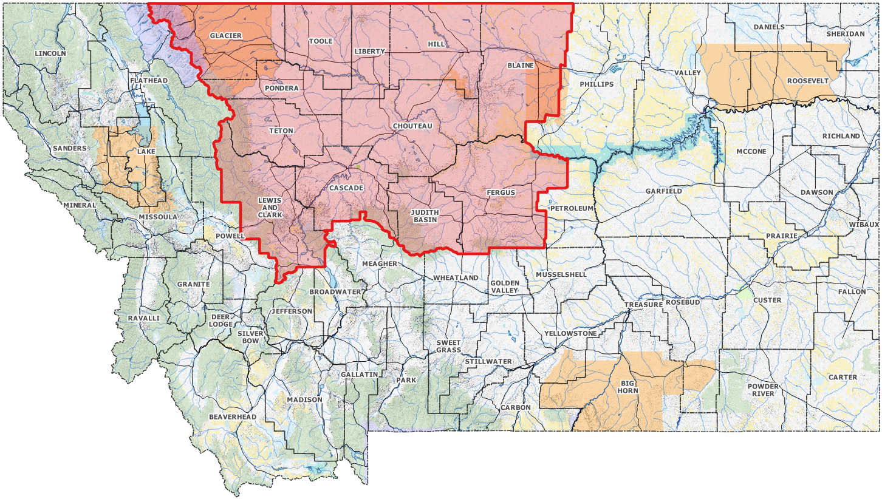
Land Value Trends - North Central Montana

Slide 22
Market Overview
Beginning in the second half of 2020, the rural land market in Montana has been very dynamic
  Covid concerns
  Escaping urban areas
Brisk sales of properties of all sizes
Primarily affected recreational/rural residential properties
Demand for agricultural properties remains strong

Slide 23
Market Factors
Limited Supply of Properties
Influx of “Out-of-Staters”
Large Operators
  Able to subsidize land purchases with other owned assets
  Strong Liquidity
Investors
Commodity Prices
Input Prices
Government Program Payments
Factors differ by market area
Market areas can be large or small
  Depends on type and size of property
    Half section of dry crop vs. 50,000 acre recreational ranch
  Historically “wetter” vs. “drier” portions of the market area

Slide 24
North Central Montana
Land Use or Class | Value Range | Unit | Activity/Trend | Rental Range | Unit | Activity/Trend
Irrigated Crop | $2,500-$4,000 | Acre | Stable | $75 - $125 | Acre | Stable
Dry Crop | $800 - $1,800 | Acre | Stable | $25 - $50 | Acre | Stable
Pasture / Range | $350 - $800 | Acre | Stable | $20 - $40 | AUM | Stable
2021

Slide 25
Questions?

